Slide 1

Property Finder Real Estate Data Analysis
Graduation Project
Data Visualization Track
Jan 2026

Slide 2
Team Project
Rahma Yasser
Kerolos Romany
Ereny Naeem
Ahmed Saad
Under the supervision of
Eng Tasneem Atta

Slide 3
Agenda Overview
01
Introduction & Tools used
02
Dataset Collection & Web Scraping
03
ERD &
Data Model
04
BI Queries (Oracle Toad)
05
Data Warehouse Creation
(MS SQL Server)
06
Data Model Implementation (SSIS)
07
Power BI & Dashboards

Slide 4
01 Introduction & Tools Used

Slide 5
This project designs and implements an end-to-end Business Intelligence (BI) solution for a real-estate management and marketing platform. It integrates operational data related to customers, agents, properties, leads, campaigns, and sales into a centralized data warehouse optimized for analytical reporting using Power BI.
The project follows standard data engineering practices, starting from data collection and scraping, through ERD and star schema design, and concluding with interactive dashboards and key performance indicators.

Slide 6














Tools used:
Python
ChatGpt
Excel
Sql Server
Oracle Toad
Miro
Visual Studio
Power Bi

Slide 7
02 Data Collection & Web Scraping

Slide 8





Objective: collect authentic Assiut real-estate market data
Approach: direct outreach to local real-estate companies
Companies visited: Neyoum, New Porto, El-Rabwa, Konoz, others
Expected: access to listing data, pricing, status history, sales funnel
Result: no cooperation or usable datasets provided
Insight: real-estate firms treat data as private and strategic asset

Slide 9

Alternative solution: scrape real listings from Property Finder
Automated extraction using custom scraping pipeline
Volume collected: ~99,000 listings
Data fields: price, location, developer, property type, size, amenities, status
Benefit: large-scale, real-world dataset reflecting actual market trends
Outcome: reliable foundation for analysis, modeling, and dashboard insights

Slide 10


Also used Kaggle for collecting the campaign & reviews datasets and it’s about 38000 different campaign & 49000 reviews.
Fastbase for agents dataset was about 3600 agent modified using chatgpt.

Slide 11
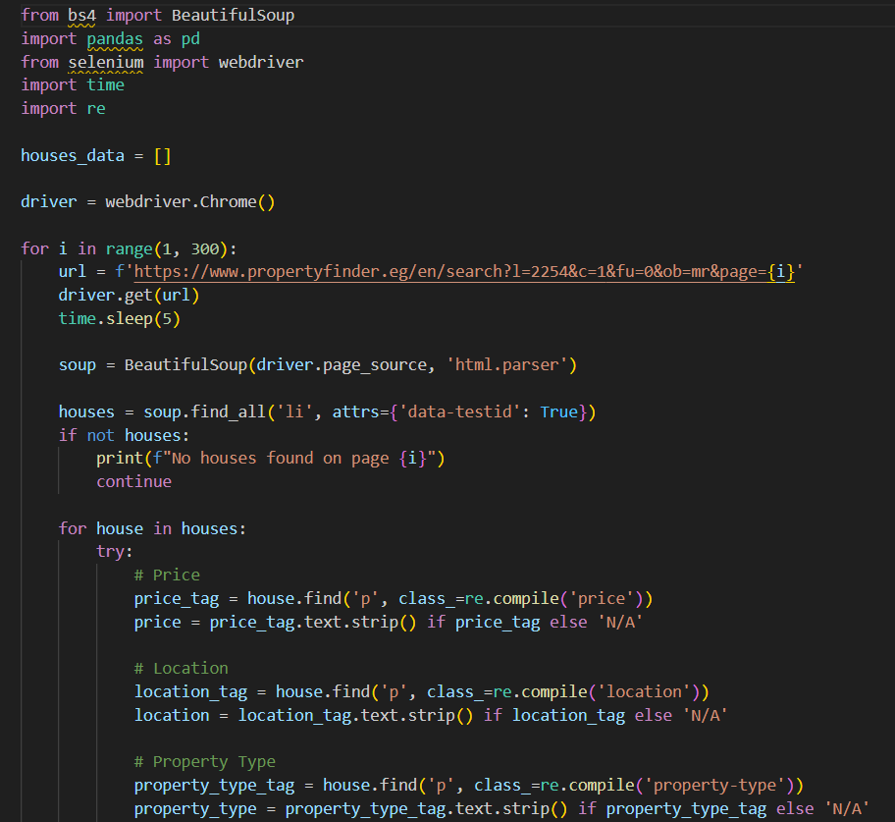
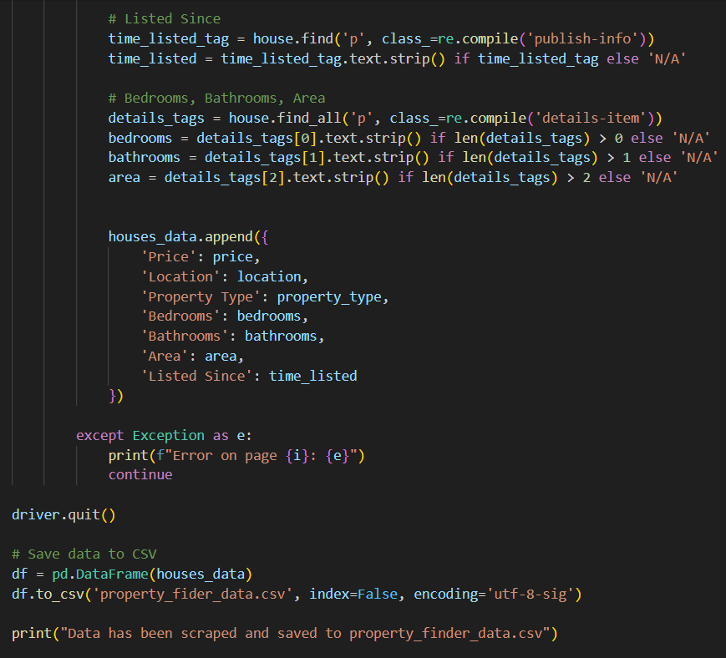
Web Scraping
(Property Finder)

Slide 12
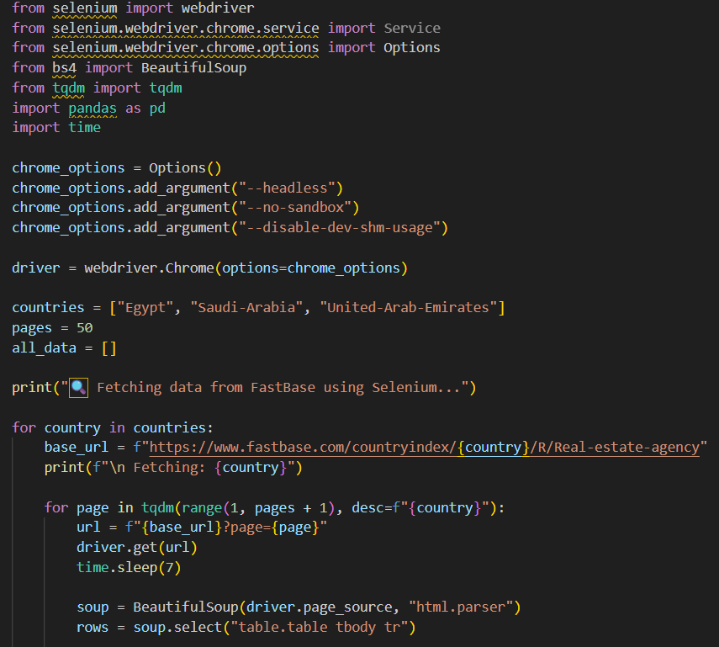
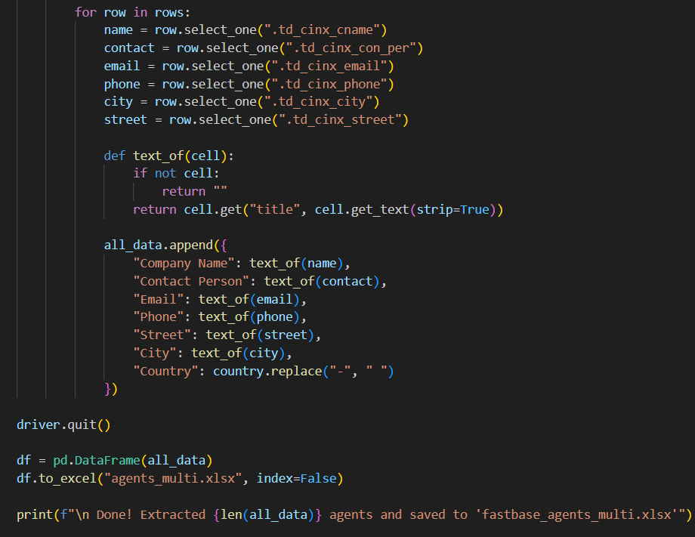
Web Scraping
(Fastbase)

Slide 13
Package | Main Function | What It Does | Typical Use in Scraping
Beautiful Soup | HTML parsing | Extracts data from page source using tags and attributes | Scraping static pages or parsed HTML
Selenium | Browser automation | Loads JavaScript content and interacts with web pages | Scraping dynamic or interactive websites
tqdm | Progress tracking | Displays progress bars for loops and long tasks | Monitoring large scraping or ETL jobs

Slide 14
03 ERD & Data Model

Slide 15
We collected and combined multiple data sources for a complete real-estate dataset
Core leads and listing data prepared, then enriched with: • Campaign and reviews data from Kaggle • Agent information from FastBase
Assigned leads data to properties, agents, and marketing campaigns
Cleaned the dataset: removed duplicates, fixed missing values, standardized formats
Designed and documented the ERD (Entity-Relationship Diagram)
Added and validated relationships between all tables for a consistent data model

Slide 16
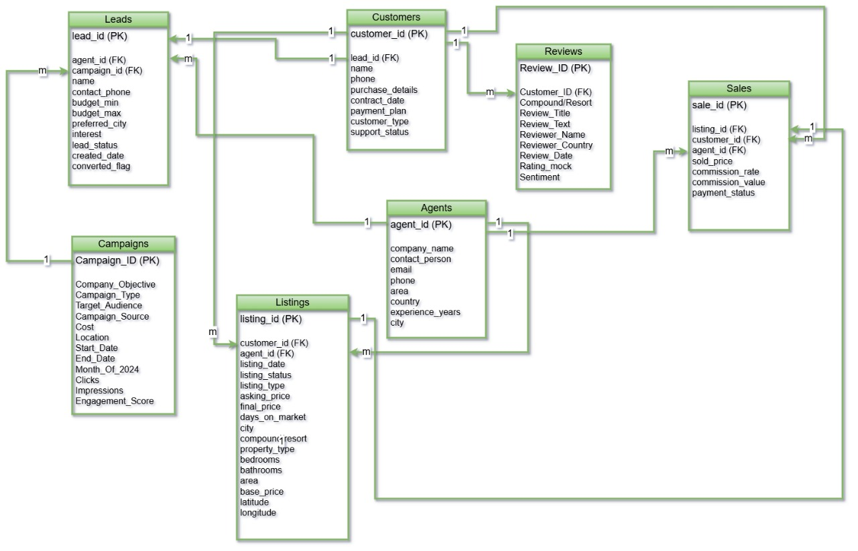
ERD

Slide 17
For the data model, we implemented a Galaxy Schema (Fact Constellation Model) to support integrated real-estate analytics. Multiple fact tables share common dimensions, enabling unified reporting across sales, leads, campaigns, and reviews.
Why Galaxy Schema
Needed to analyze multiple business processes: Leads → Listings → Sales → Reviews
Shared dimensions: Date, Agents, Listings, Leads, Campaigns
Reduces data duplication across facts
Supports scalable analytics as business grows
Enables cross-process KPIs (conversion rates, ROI, agent performance)

Slide 18
Model Structure
Fact Tables
Fact Leads — lead status, conversion flags, agent & campaign tracking
Fact Sales — final prices, commission rates, financial outcomes
Dimension Tables
Dim Agents — agent profile, experience
Dim Leads — customer & lead attributes
Dim Listings — property details
Dim Campaigns — marketing info & performance
Dim Reviews — customer sentiment
Dim Date — unified time intelligence

Slide 19
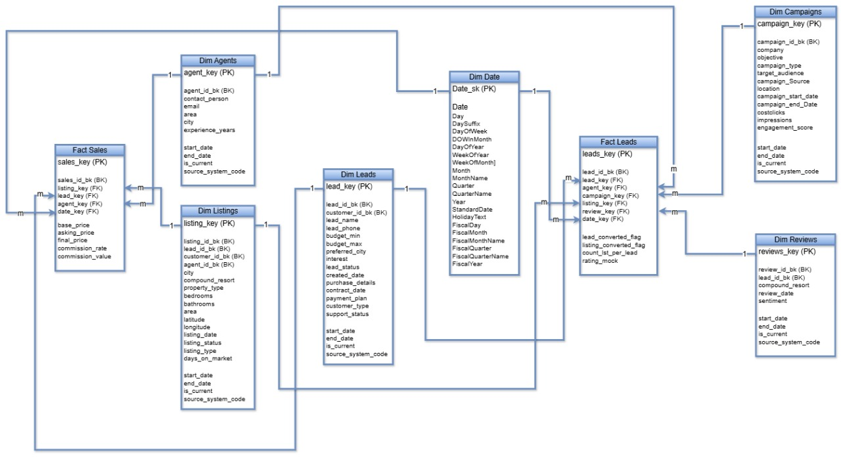
Data Model

Slide 20
04 BI Queries

Slide 21
To support business intelligence analysis, this project relies on Oracle SQL as the primary querying tool. Advanced SQL techniques such as JOINs, Common Table Expressions (CTEs), aggregations, and conditional logic are used to integrate data across multiple entities including customers, leads, agents, campaigns, listings, sales, and reviews.
In addition, PL/SQL packages and stored procedures are implemented to encapsulate complex analytical logic, such as campaign ROI calculations, and to provide reusable, parameterized reports through REF CURSORs. These queries form the analytical backbone of the BI layer and are later consumed by Power BI for visualization, KPI tracking, and decision support

Slide 22


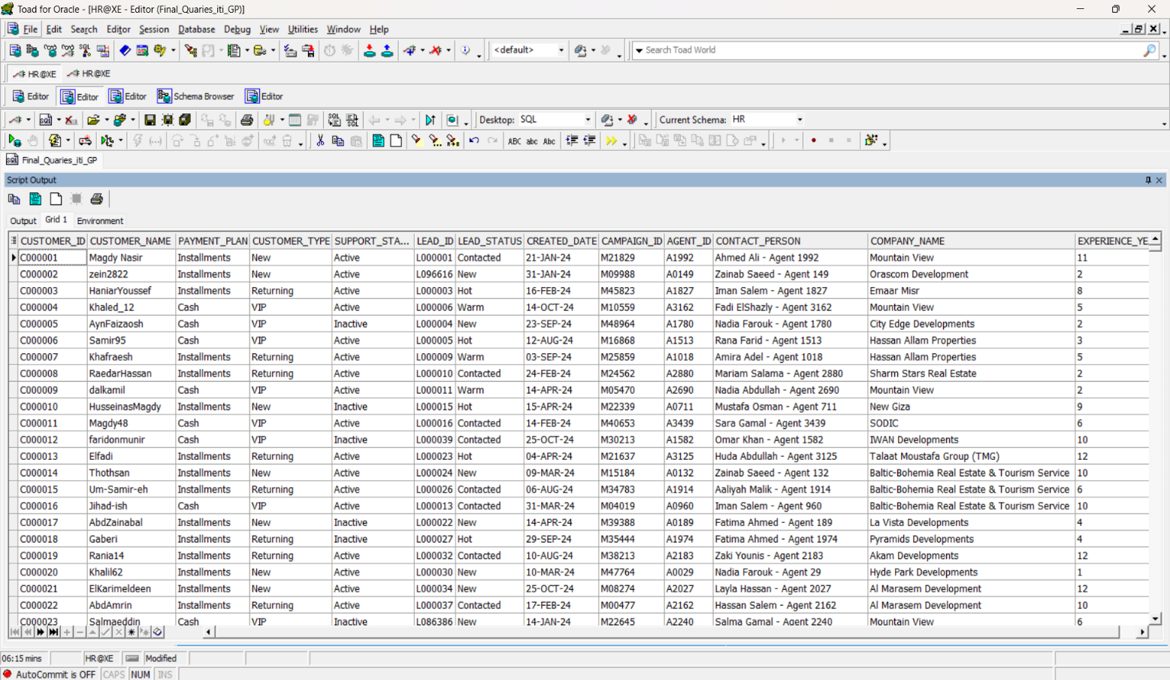
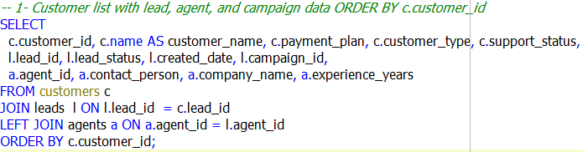
1. Customer list with lead, agent, and campaign data ORDER BY c.customer_id

Slide 23
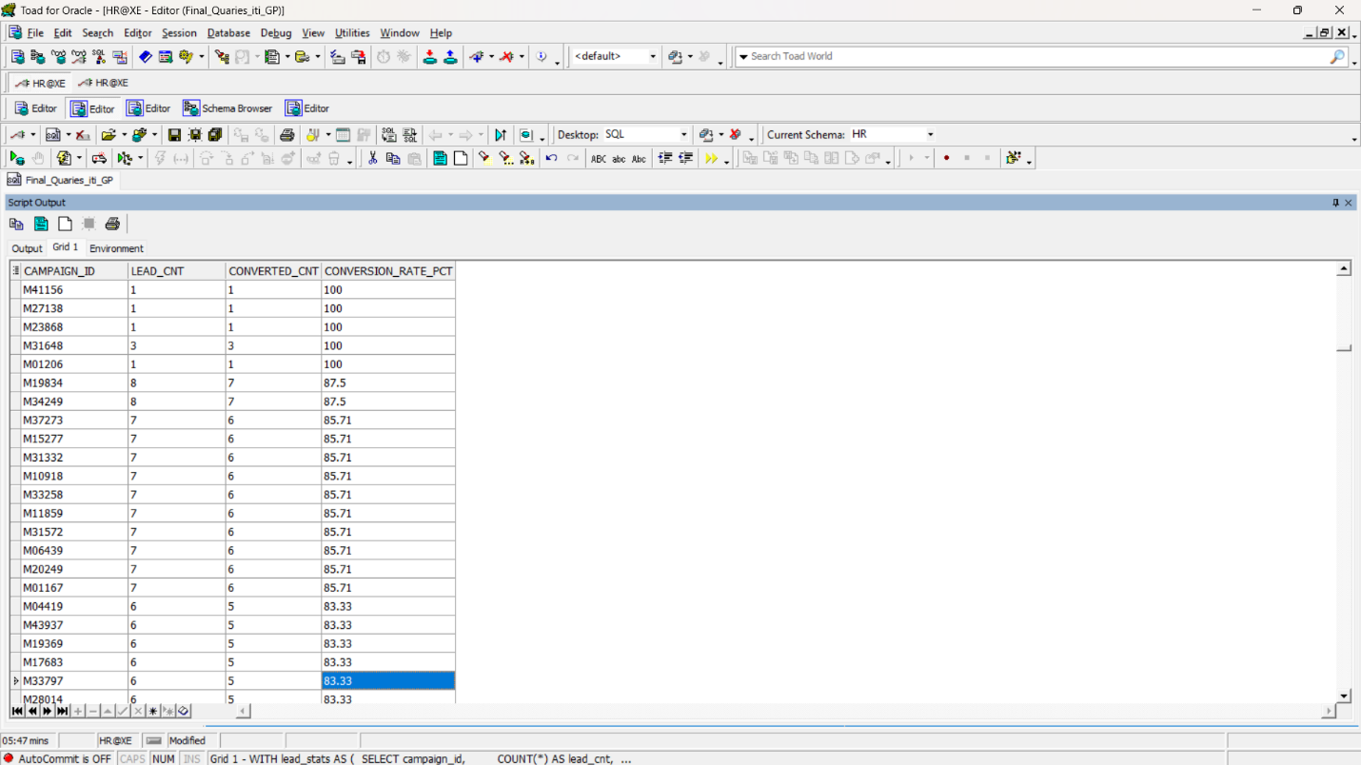
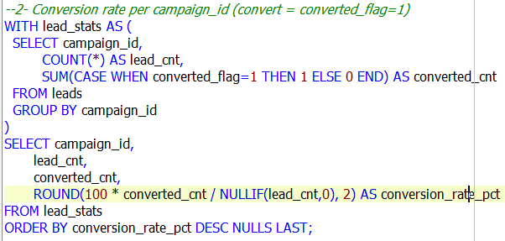
2. Conversion rate per campaign_id (convert = converted_flag=1)

Slide 24
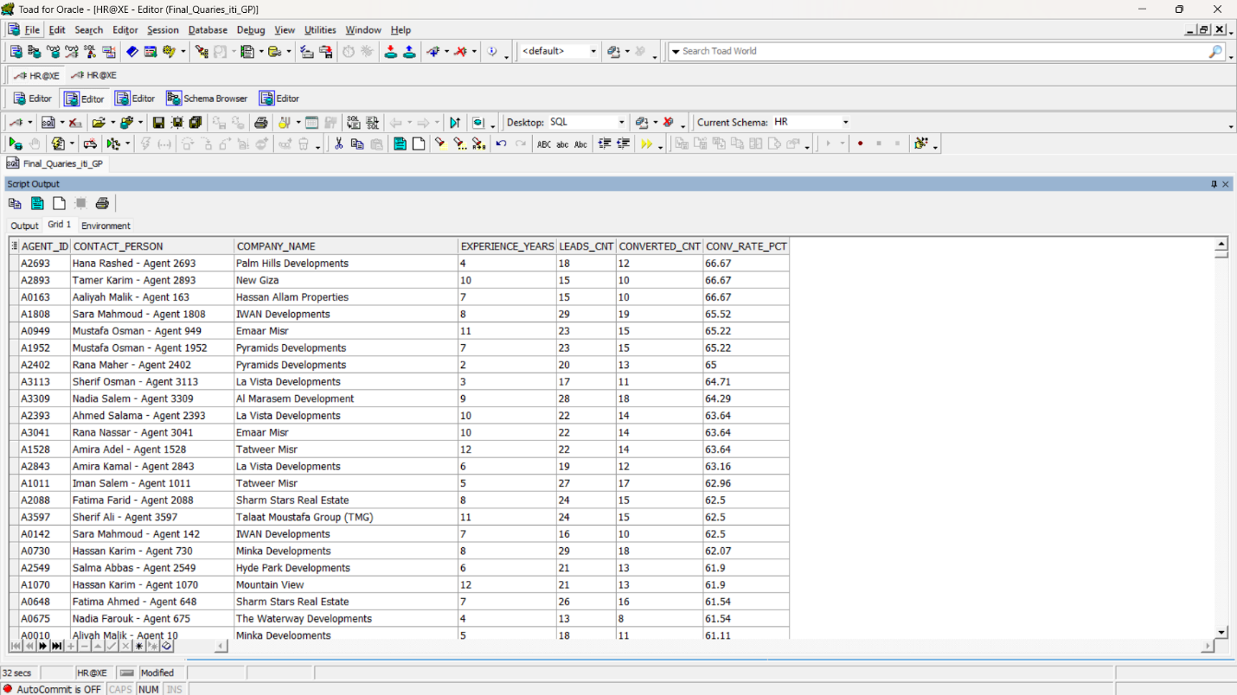
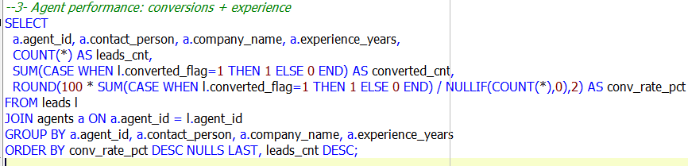
3. Agent performance: conversions + experience

Slide 25
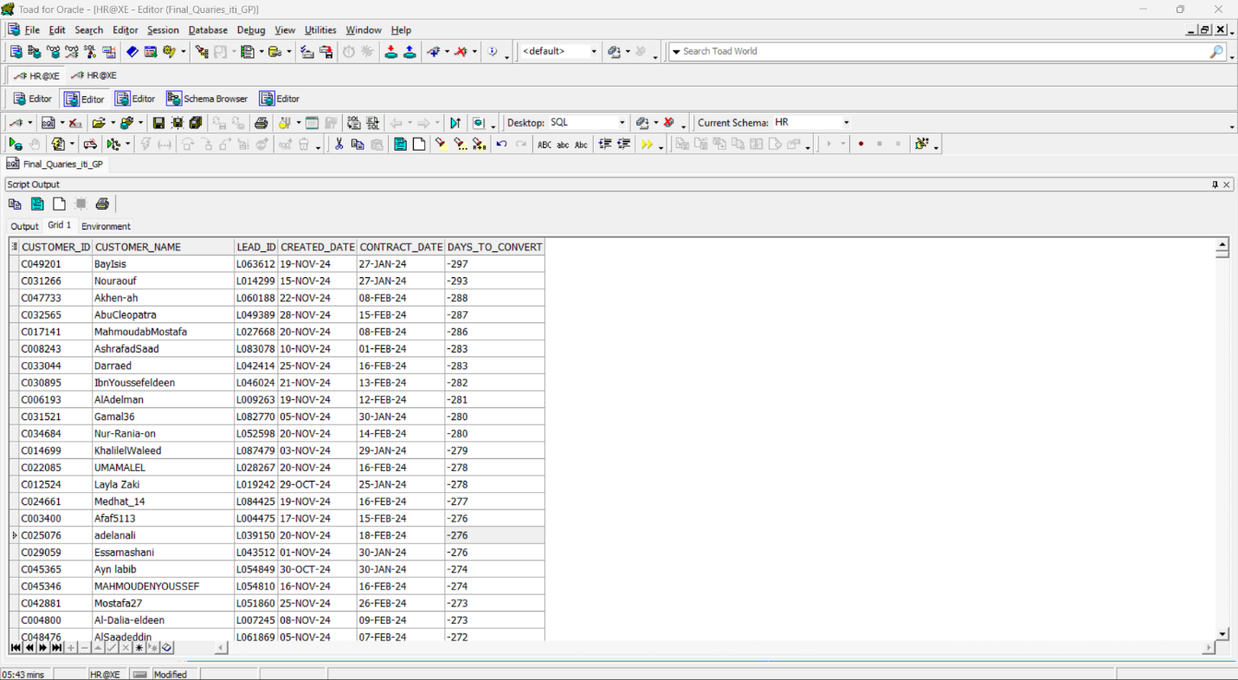
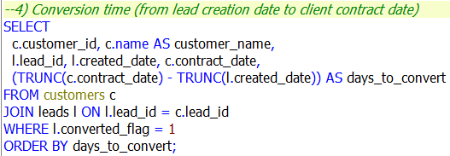
4. Conversion time (from lead creation date to client contract date)

Slide 26
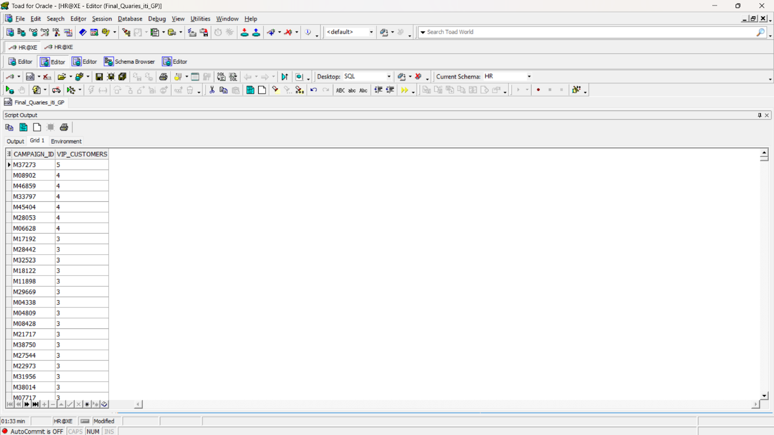
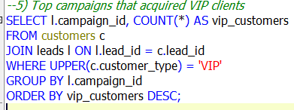
5. Top campaigns that acquired VIP clients

Slide 27
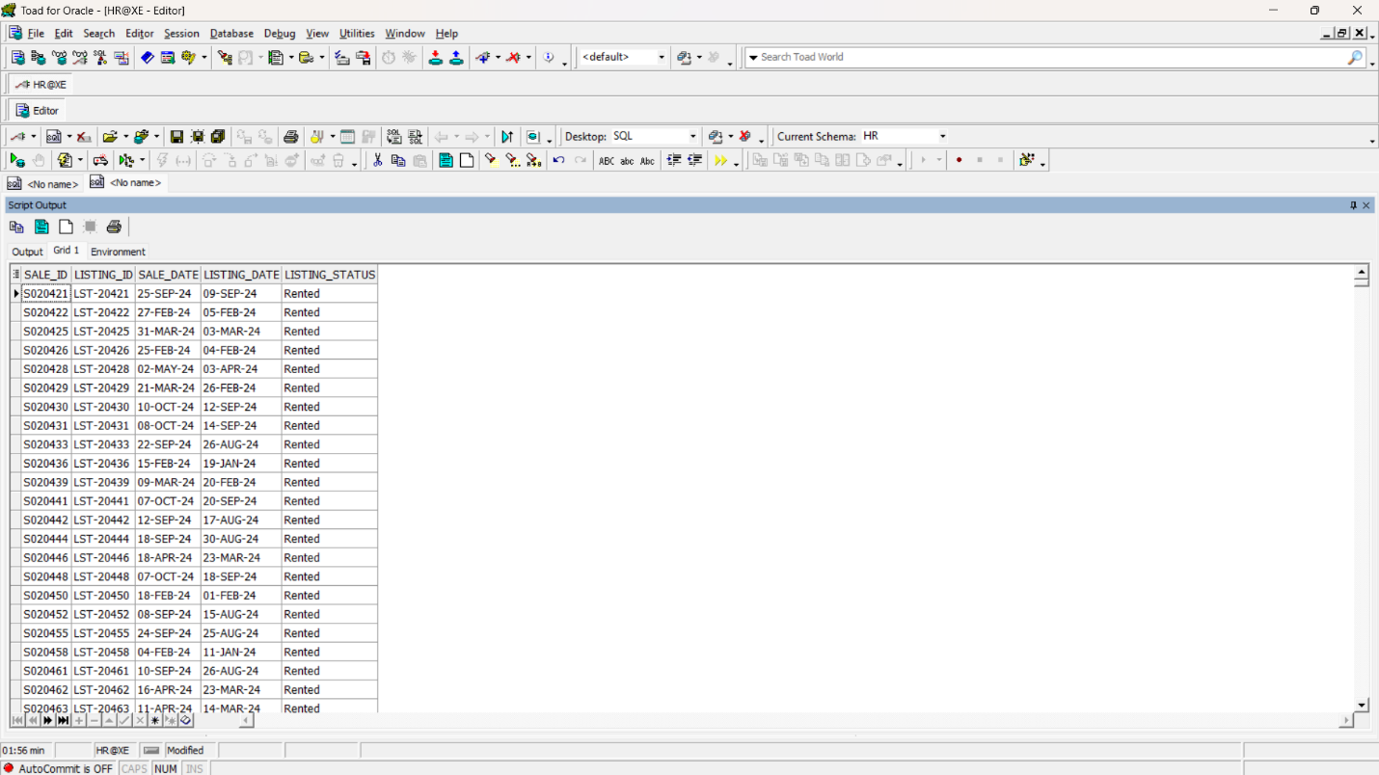
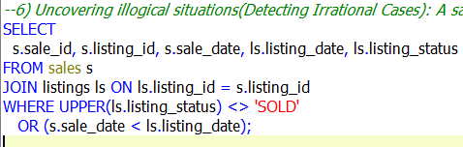
6. Uncovering illogical situations(Detecting Irrational Cases): A sale where the listing status is not “SOLD” or a sale date prior to the listing date

Slide 28
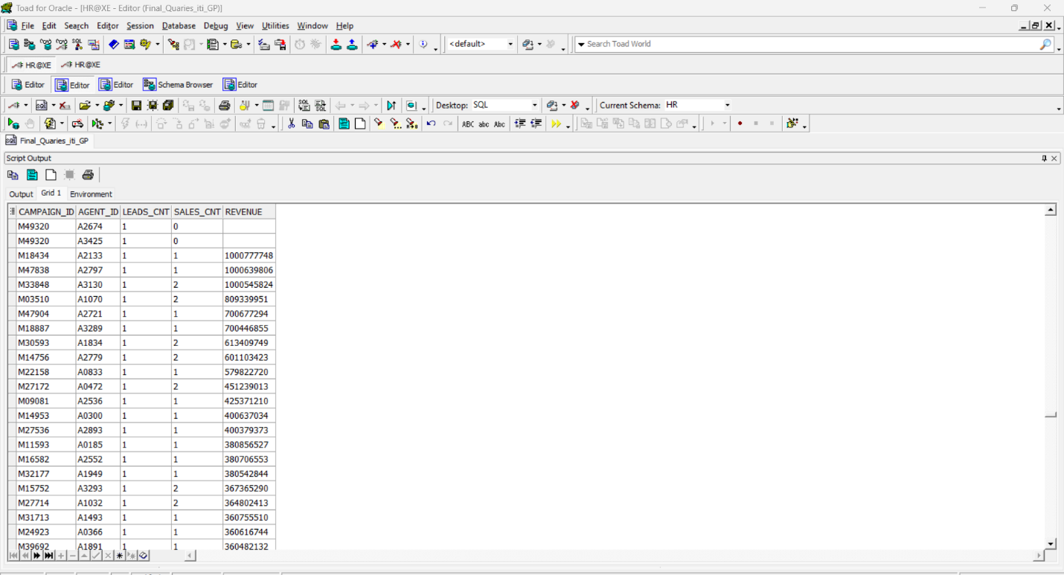
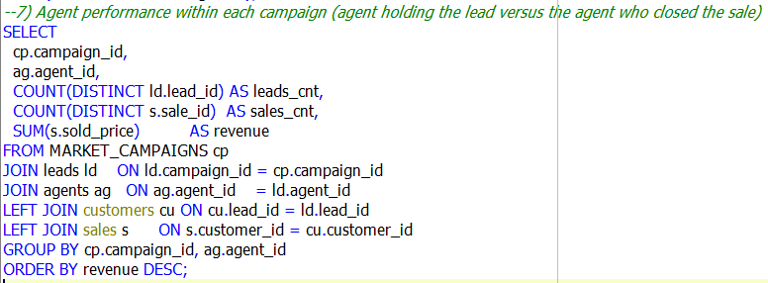
7. Agent performance within each campaign
(agent holding the lead versus the agent who closed the sale)

Slide 29
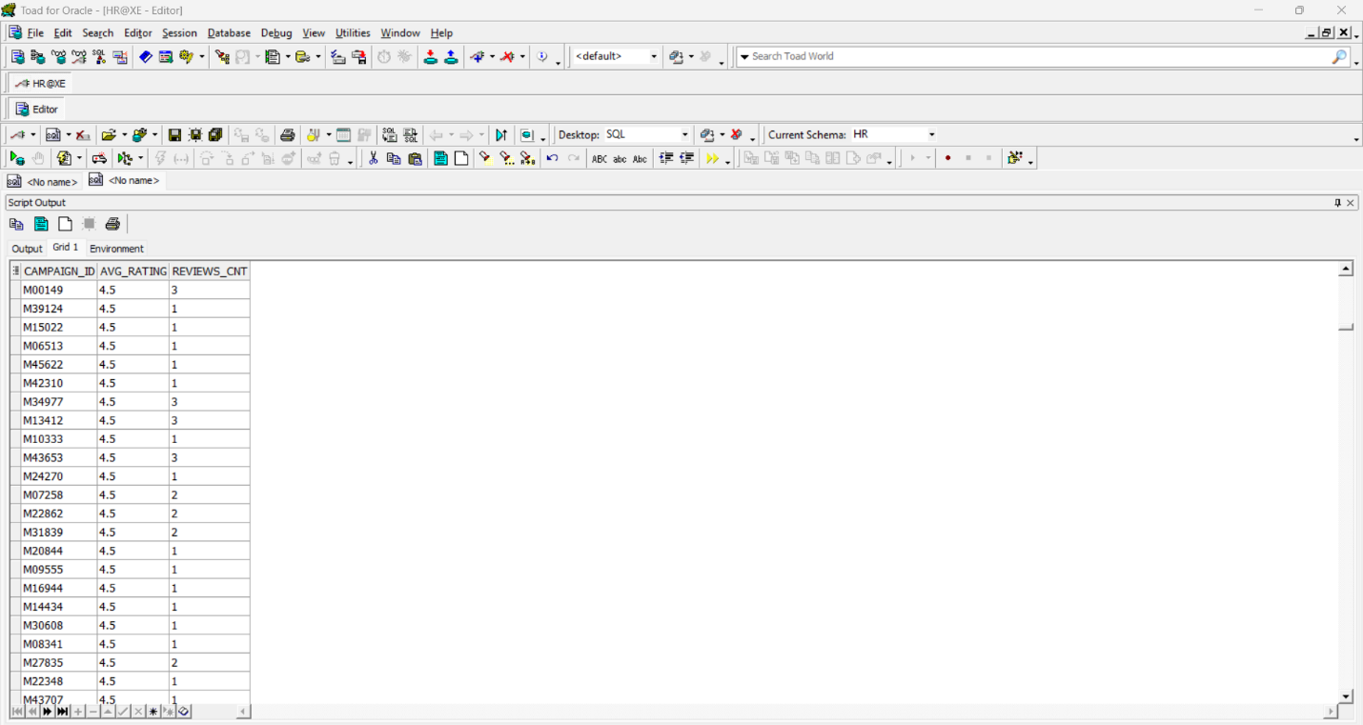
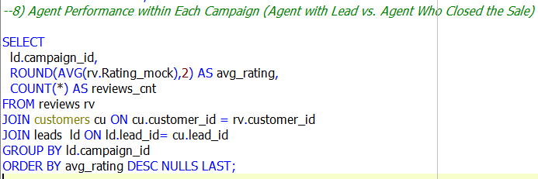
8. Agent Performance within Each Campaign
(Agent with Lead vs. Agent Who Closed the Sale)

Slide 30
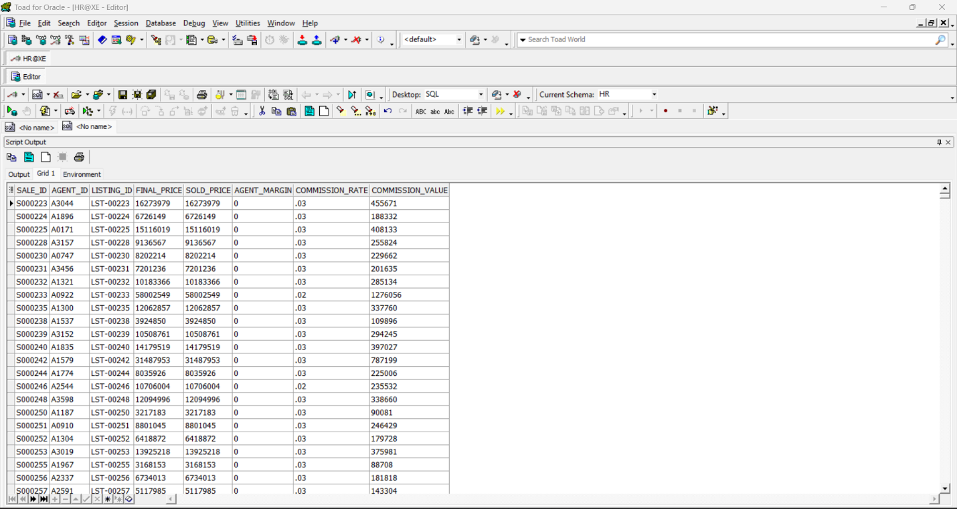
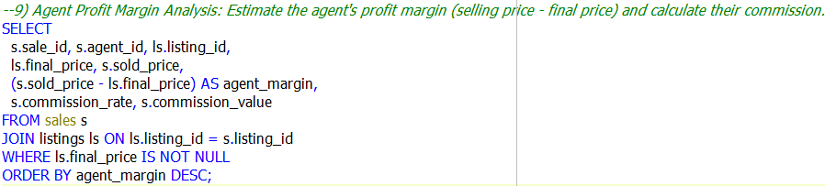
9. Agent Profit Margin Analysis: Estimate the agent's profit margin (selling price - final price) and calculate their commission.

Slide 31
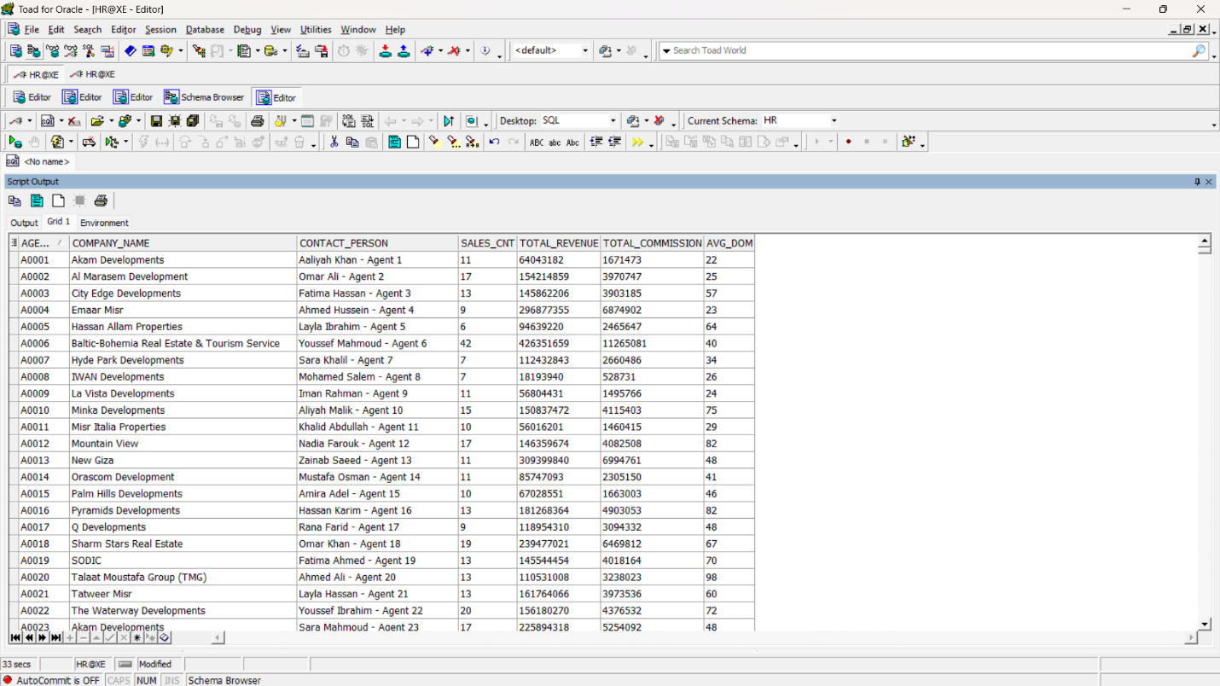
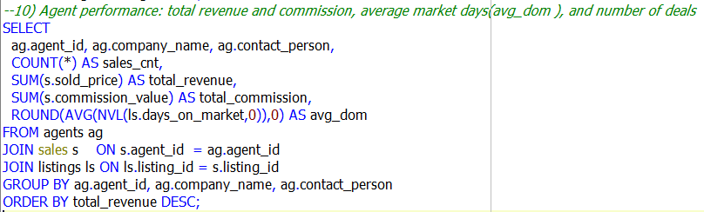
10. Agent performance: total revenue and commission, average market days(avg_dom ), and number of deals

Slide 32
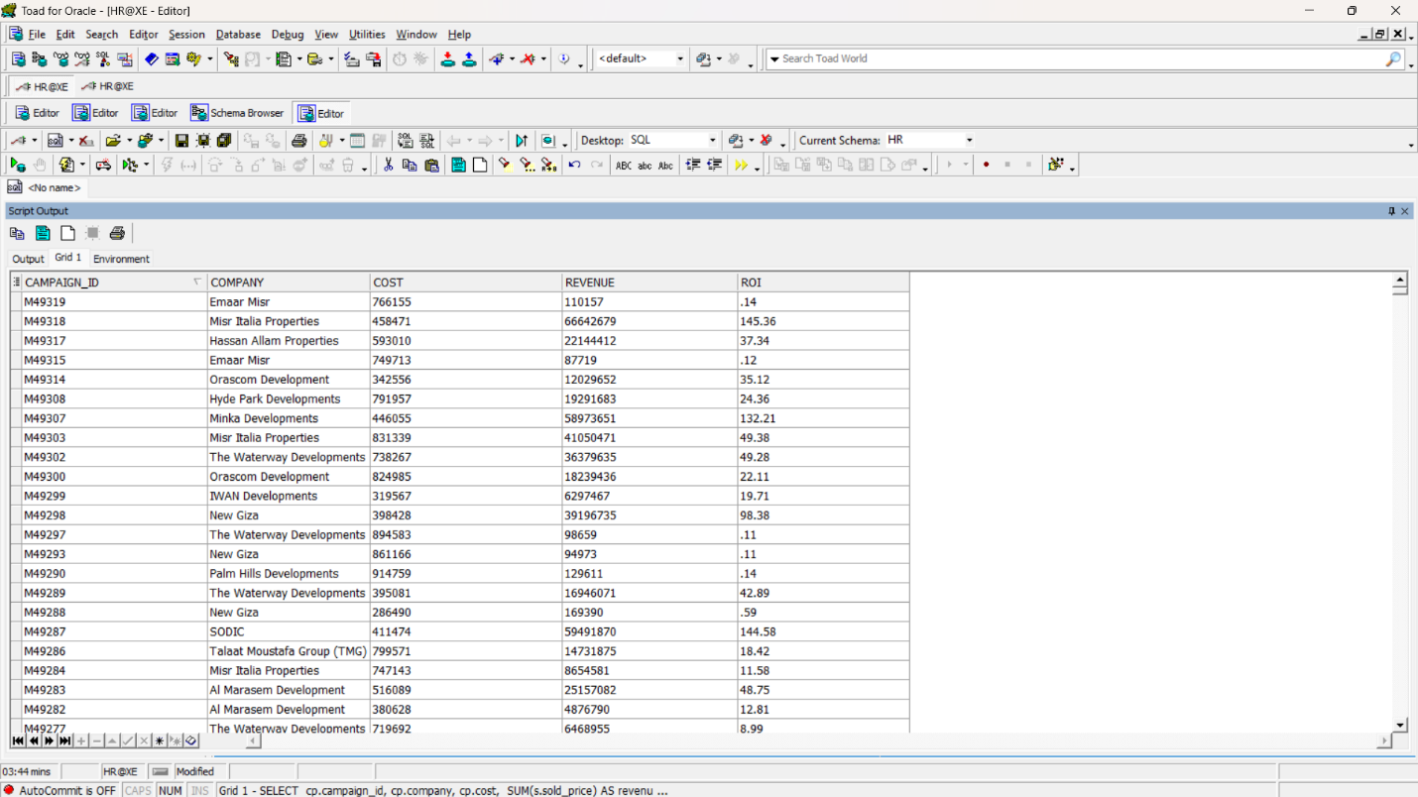
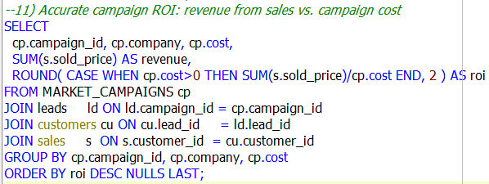
11. Accurate campaign ROI:
revenue from sales vs. campaign cost

Slide 33
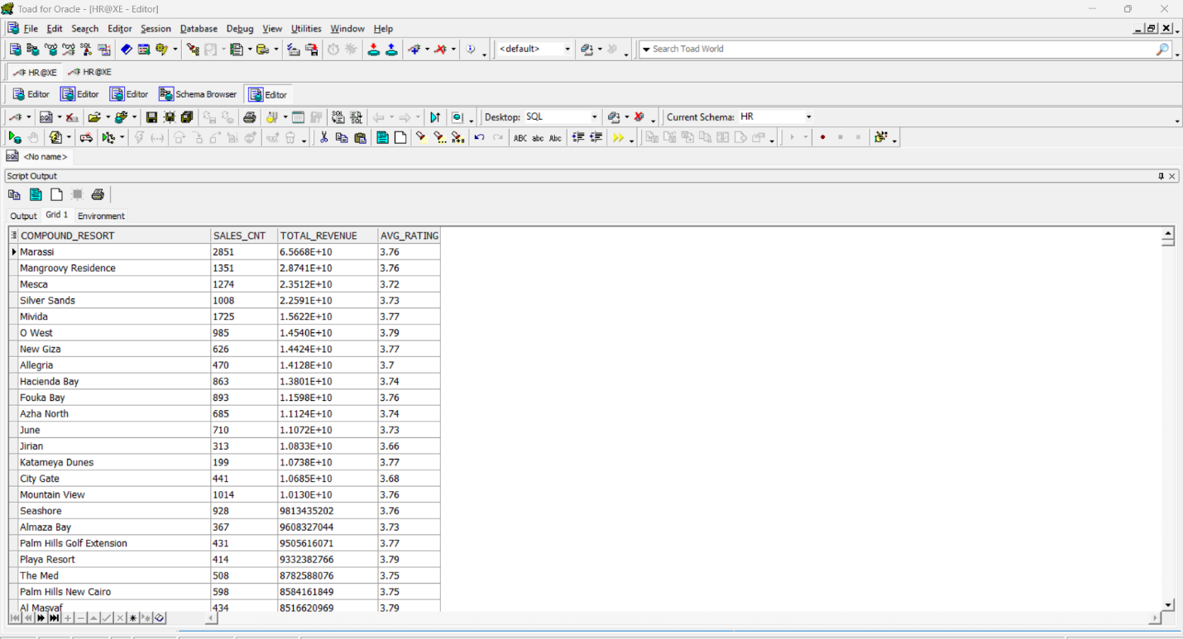
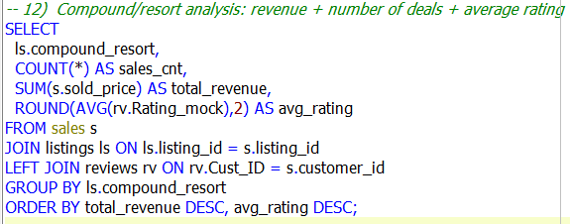
12. Compound/resort analysis:
revenue + number of deals + average rating

Slide 34
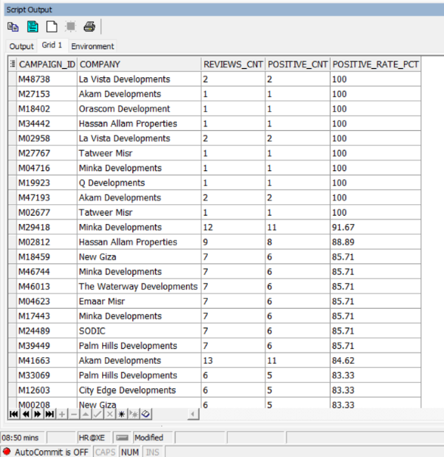
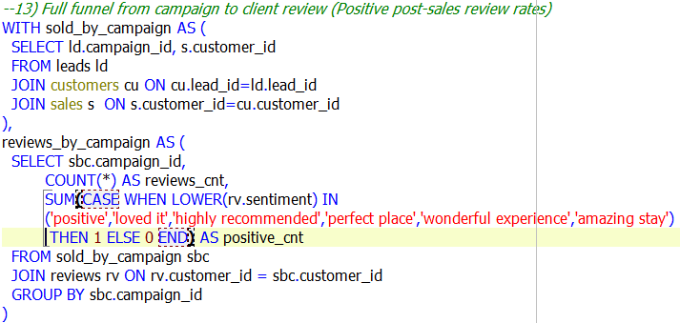
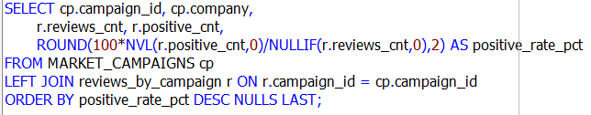
13. Full funnel from campaign to client review
(Positive post-sales review rates)

Slide 35
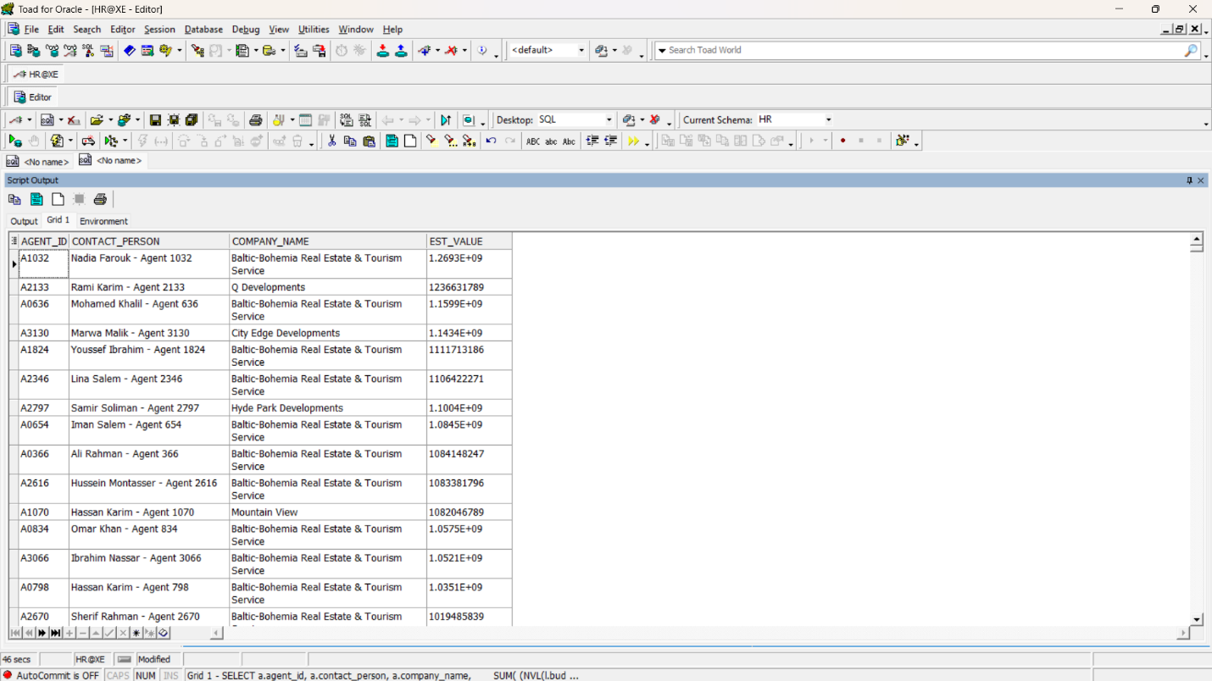
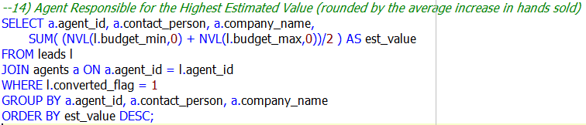
14. Agent Responsible for the Highest Estimated Value
(rounded by the average increase in hands sold)

Slide 36
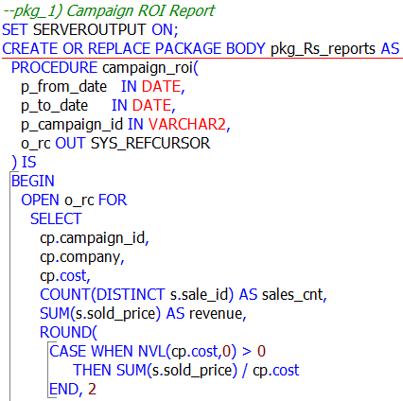
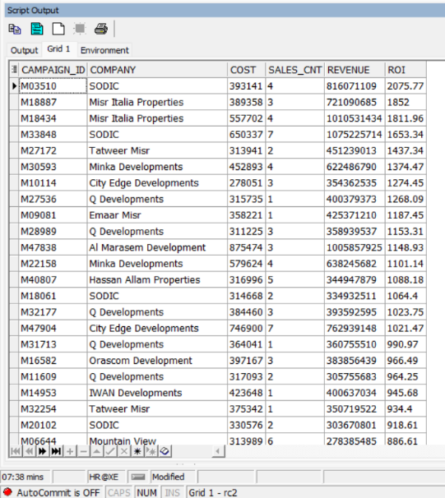
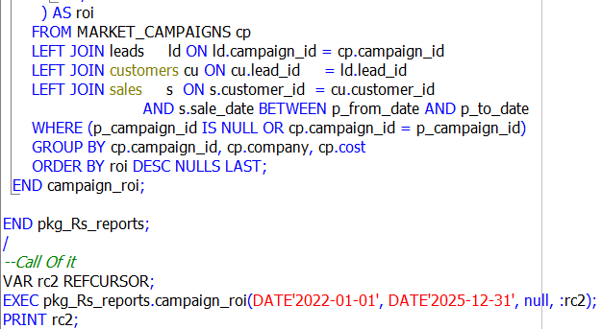
15. pkg_1: Campaign ROI Report

Slide 37
05 Data Warehouse (MS SQL Server)

Slide 38
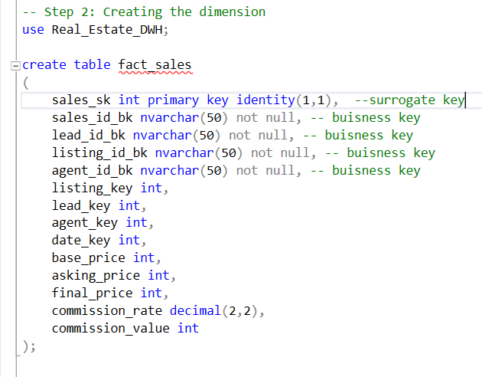
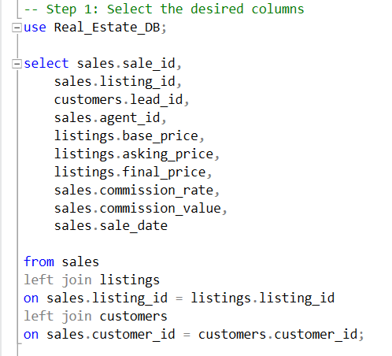
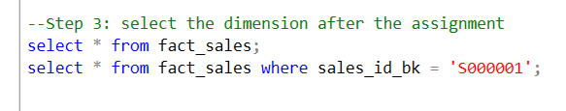
Fact Sales

Slide 39
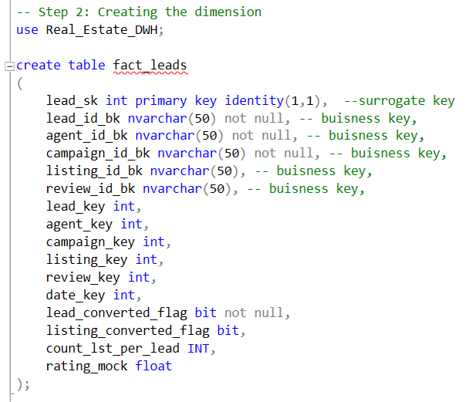
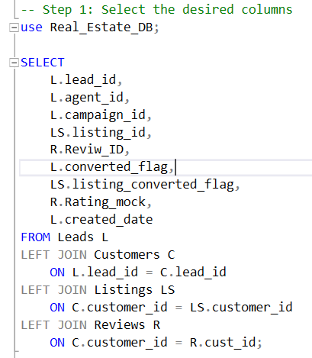
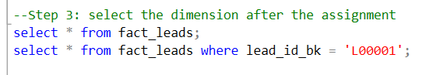
Fact Leads

Slide 40
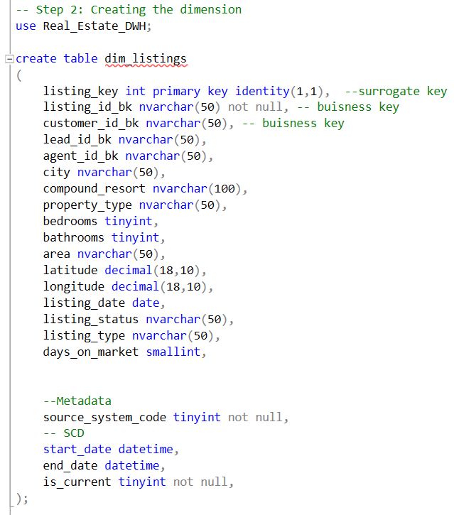
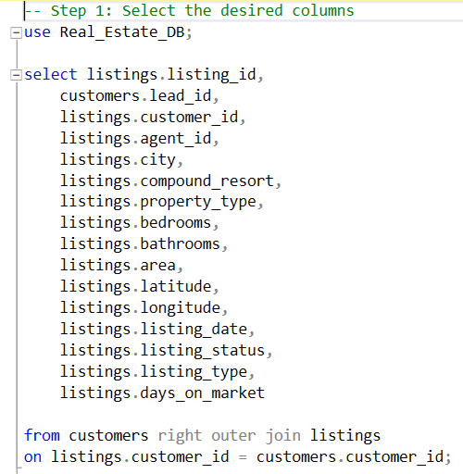
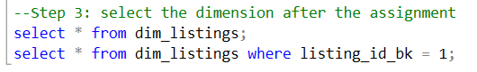
Dim Listings

Slide 41
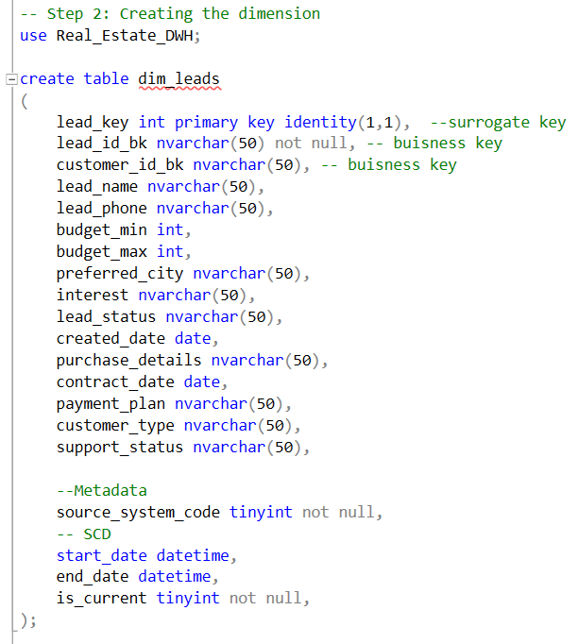
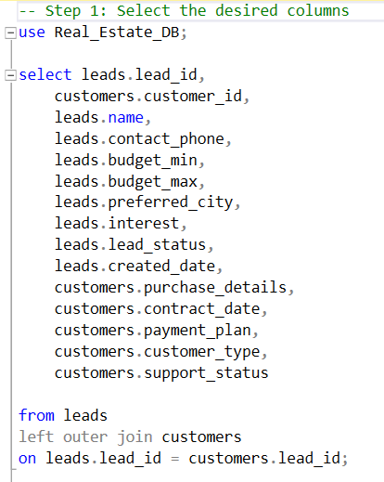
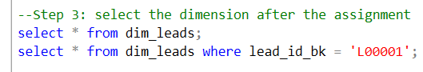
Dim Leads

Slide 42



Dim Reviews

Slide 43



Dim Campaigns

Slide 44



Dim Agents

Slide 45
06 Data Model Implementation (SSIS)

Slide 46

Fact Sales

Slide 47

Fact Leads

Slide 48


Dim Listings

Slide 49


Dim Leads

Slide 50

Dim Reviews

Slide 51


Dim Campaigns

Slide 52


Dim Agents

Slide 53
07 Power BI & Dashboards

Slide 54
Power BI Dashboard Overview
We built an interactive dashboard in Power BI to monitor and analyze real-estate performance across key business indicators. The visuals help us track market coverage, company performance, and conversion efficiency in Egypt’s real-estate sector.

Slide 55

Data Model

Slide 56

Overview

Slide 57

Listings 1

Slide 58

Listings 2

Slide 59

Listings 3

Slide 60

Agents

Slide 61

Leads 1

Slide 62

Leads 2

Slide 63

Campaign 1

Slide 64

Campaign 2

Slide 65

Campaign 3

Slide 66

Campaign 4

Slide 67

Campaign 5

Slide 68

Customers 1

Slide 69

Customers 2

Slide 70

Sales 1

Slide 71

Sales 2

Slide 72

Sales 3

Slide 73

Reviews

Slide 74
Recommendations
Prioritize high-performing cities (Cairo and Giza)
Focus on apartments and villas as core property types
Reduce days on market in slow-performing cities
Replicate top agent best practices across the team
Optimize the lead conversion funnel
Increase investment in high-ROI marketing channels
Target VIP and returning customers
Align marketing objectives with conversion performance
Improve customer satisfaction and review management
Leverage seasonal sales peaks

Slide 75
THANK YOU
Jan 2026

